Slide 1
Modern Management – Windows 10
Moving to Modern Management
Jodie LeFever| Sr. Technical Specialist| EDU Midwest
This Photo by Unknown Author is licensed under CC BY-SA

Slide 2
Education is a Unicorn
A large user base where the majority are consumers (students)
Employees (educators) who are often willing to experiment with technology in the pursuit of productivity/efficacy
A changing demographic of consumers who demand the latest tech
An IT department that is understaffed
This Photo by Unknown Author is licensed under CC BY-SA

Slide 3
MEET SAM
IT director with a small team managing 5,000 staff and student devices
Struggles with managing Windows updates and has numerous confusing ways to manage the devices
Staff and students complain about login times and other disruptions to learning
Sam needs to transform her practices with Modern Management!
This Photo by Unknown Author is licensed under CC BY-SA

Slide 4
What does Modern Mangement look like?
Retire
Deploy Apps & Scripts
Provisioning instead of imaging
All Cloud based
Better performance on devices
Manage devices
Manage users
Packages SCCM
Manual
Provision
devices
AutoPilot
This Photo by Unknown Author is licensed under CC BY-SA

Slide 5
What if I still want to use SCCM?
Microsoft Endpoint Manager
Co-management
Switch workloads as needed/ready
This Photo by Unknown Author is licensed under CC BY-SA

Slide 6
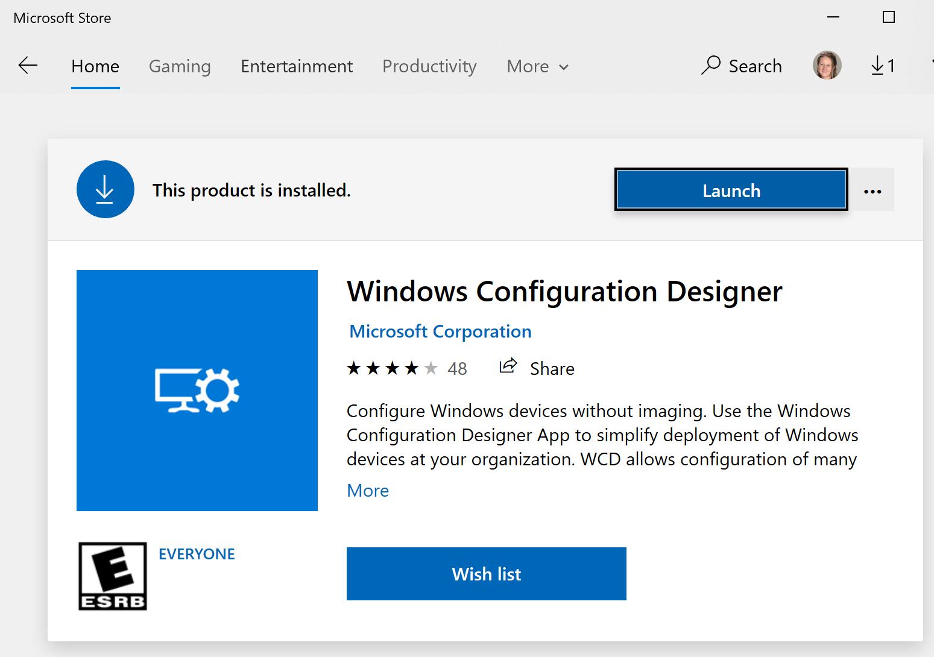
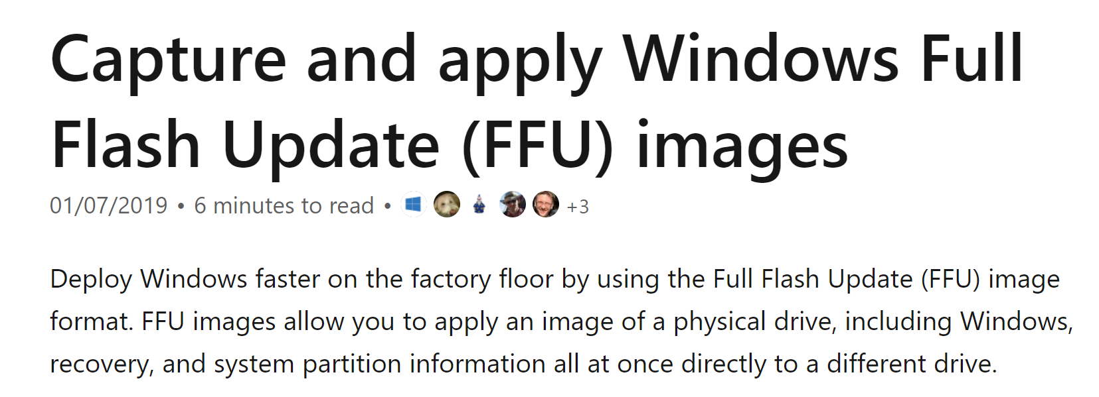
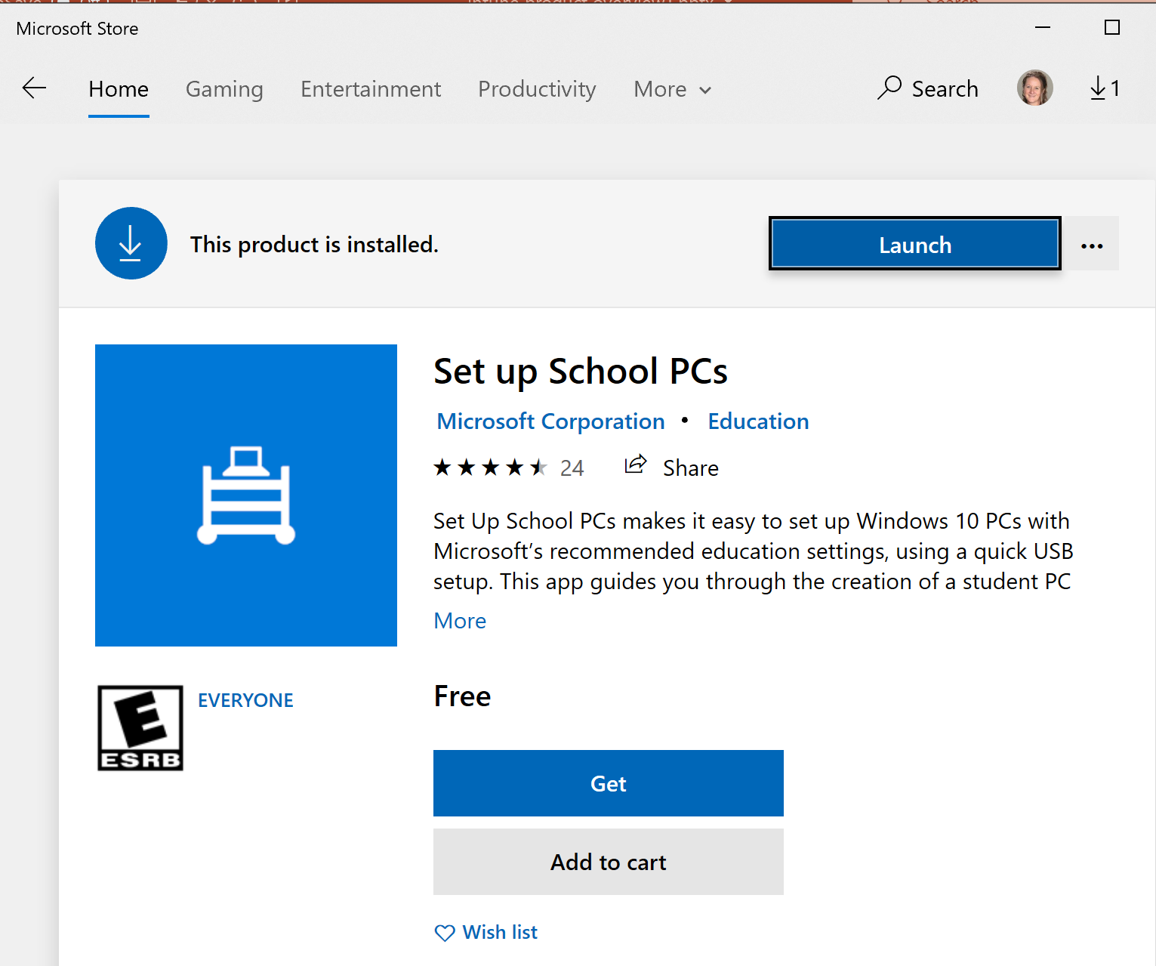
Provisisioning/Bootable Media
Aka.ms/FFU
Password: ffu!
1
This Photo by Unknown Author is licensed under CC BY-SA

Slide 7
Modern desktop provisioning with Windows Autopilot
Register devices
Autopilot profile sync
Existing PC estate
Autopilot Service
Intune and Azure AD
IT Admin
Register devices, configure profiles
Self-deploy
New PC vendor
New Devices
User
Deliver direct to Employee
Provision new devices direct to employees, ready for use
Upgrade existing devices, reimaged with Autopilot
Lower IT effort and cost; user gets productive faster

Slide 8
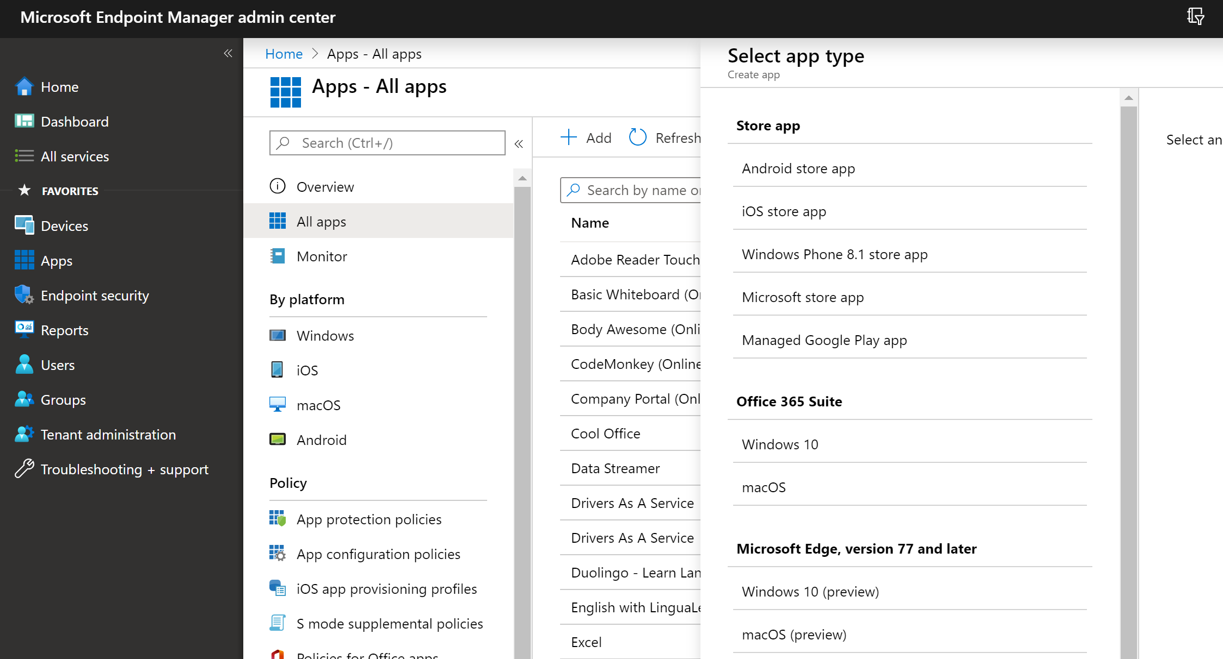
Demo Time!
Deploying Office and Teams
This Photo by Unknown Author is licensed under CC BY-SA

Slide 9
Managing Windows Updates
This Photo by Unknown Author is licensed under CC BY-NC
This Photo by Unknown Author is licensed under CC BY-SA

Slide 10
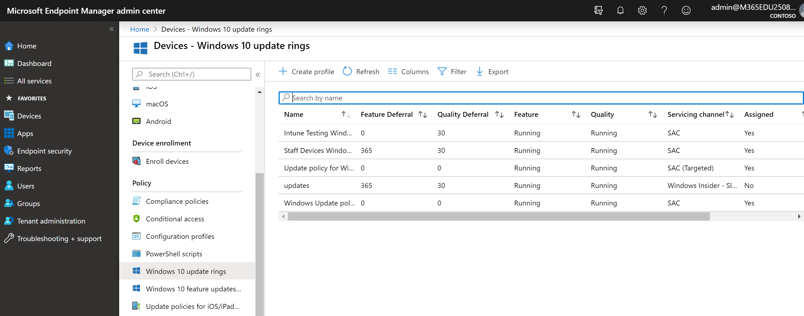
Demo Time!
Deploying Windows Updates
This Photo by Unknown Author is licensed under CC BY-SA

Slide 11
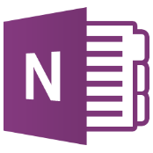
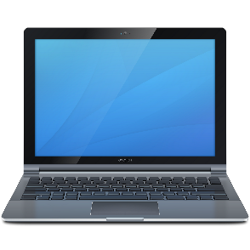
Intune/Intune
for Education
With her PCs deployed at record time, she looks for her next challenge
Sam and her small team are now unstoppable thanks to Modern Management!
Staff and Students access M365 daily by logging into their Intune managed devices.
This Photo by Unknown Author is licensed under CC BY-NC
This Photo by Unknown Author is licensed under CC BY-SA
This Photo by Unknown Author is licensed under CC BY-SA

Slide 12
FastTrack for all Microsoft 365 customers
Team of engineers to help plan your deployment, included with every subscription
Deploy new cloud capabilities
Light up Microsoft 365 services, migrate email and content
Enable intelligent communications and chat-based collaboration
Deploy and securely manage devices
Access engineering expertise
End-to-end guidance built by Microsoft engineering
Access self-serve tools and resources
Guidance delivered remotely by Microsoft engineers or approved partners
Gain user adoption
Create a holistic plan to accelerate user adoption
Proven methodologies for a successful implementation
Resources to increase capacity for change management
Notes:
FastTrack for Microsoft 365 helps you decrease time-to-value when deploying and enabling cloud solutions.
FastTrack is already included in your eligible subscription, which means there’s no additional cost. You can use FastTrack for your first deployment and any others throughout your subscription.
With over 60,000 customers enabled to date, FastTrack helps maximize ROI, accelerate deployment, and increase adoption across your organization.
Specifically, FastTrack can help:
Deploy new cloud capabilities – Whether it’s your first cloud deployment or your fifth, FastTrack is here to help
Onboard to Microsoft 365 services and migrate your data
Deploy chat-based collaboration and productivity apps
Enable identity, device management and modern security
Deliver assessment and remediation guidance to help prep your infrastructure for the cloud
Access engineering expertise – Whether you work with a Microsoft employee, a partner or on your own, customers benefit from Microsoft’s engineering expertise and best practices
End-to-end guidance built by Microsoft engineering
Access self-serve tools and resources
Engineering guidance delivered remotely from Microsoft engineers or approved partners
Gain user adoption – Help customers adopt new solutions quickly – the faster users adopt, the quicker it is to achieve business objectives, deliver value, and achieve ROI from your investment
Create a holistic plan to accelerate user adoption
Proven methodologies for a successful implementation
Resources to increase capacity for change management

Slide 13
Thank you!​
Jodie LeFever
Sr Technical Specialist EDU - Midwest
Jodie.LeFever@Microsoft.com

